Slide 1

2016 Presidential Election Voter analysis
Nancy Campos, Hannah Huntoon, Sarah Miller
Notes:
Sarah

Slide 2
ANALYZING VOTER TRENDS
Which factors influence voter trends? Which factors have the greatest influence on voters?
Marital Status
Education
Health Care Coverage
Location
Income

Slide 3
Data Set: 2016 Views of the electorate research Survey
Original focus was voter registration, but our scope shifted to look at candidates voted for.
Our data came from an online survey conducted by The Democracy Fund Voter Study Group and YouGov. The survey asked 116 questions from a sample size of 8,637. Questions ranged from basic demographic information to political preferences.

Slide 4

METHOD
Data pulled from the Democratic Fund Voter Study Group and YouGov
Reviewed documentation for relevant columns
Python
Pandas and Jupyter notebook
Matplotlib

Slide 5
SURVEY PARTICIPANTS DEMOGRAPHICS
Participants were recruited from the 2012 Cooperative Campaign Analysis Project (CCAP) and used a sample matching procedure managed by YouGov.
Participants differed in age, marital status, political views, educational attainment, etc.
Sample size included 8,637 participants, 7,038 remaining after cleaning data
District of Columbia was included as a “state” – 51 total locations
Data included all possible candidates. We narrowed our analysis to focus on the two major candidates: Hillary Clinton and Donald Trump.

Slide 6
Data exploration and clean up
Removed blanks
Created data frames with relevant columns
Re-named column headers
Looked for unique values
Grouped by variables of interest based on “candidate voted for”
Notes:
Sarah

Slide 7
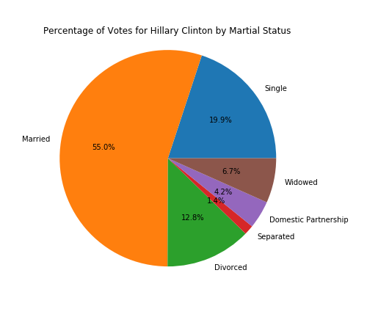
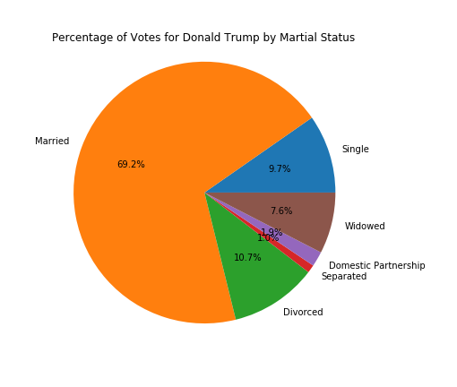
Is MARITAL STATUS correlated with VOTER PATTERNS?
Notes:
What did we notice? Trump had 14.2% more married voters than Clinton. Clinton had 10.2% more single voters than Trump. Clinton had 2.3% more voters who were in a domestic partnership than Trump.

Slide 8
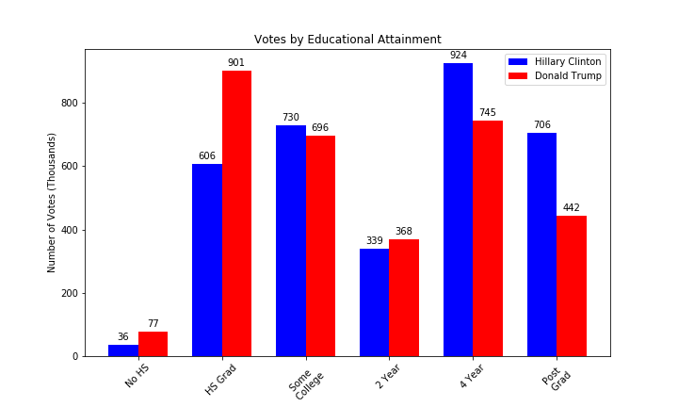
IS EDUCATIONAL ATTAINMENT CORRELATED WITH VOTER PATTERNS?
Notes:
What did we notice? The largest three groups for Trump, in order, were high school graduates, 4-year college degree holders, and voters who attended some college. The largest three groups for Clinton, in order, were 4-year college degree holders, some college, and post-grad. For HS grad there was a 39% difference between the two candidates. For post grad there was a 46% difference between the two.

Slide 9
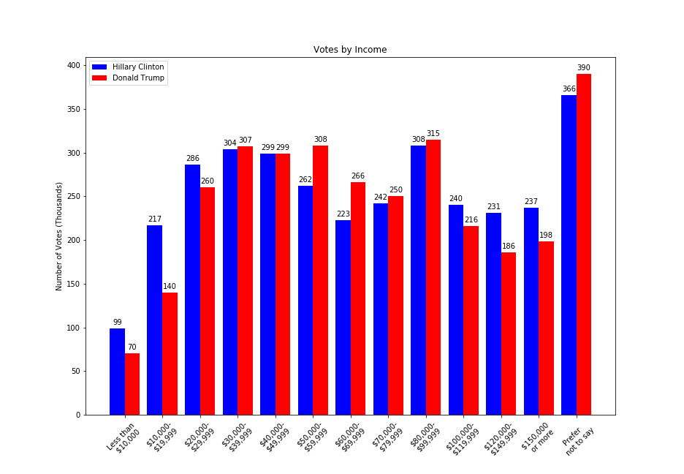
IS HOUSEHOLD INCOME Correlated with VOTER PATTERNS?
Notes:
HC had more votes on opposite ends of the spectrum (less than $10,000 - $29,999 AND $100,000 - $150,000+). DT more votes in the mid-range for income ($50,000 - $99,999). At $40,000 - $49,999 there was an exact tie.

Slide 10
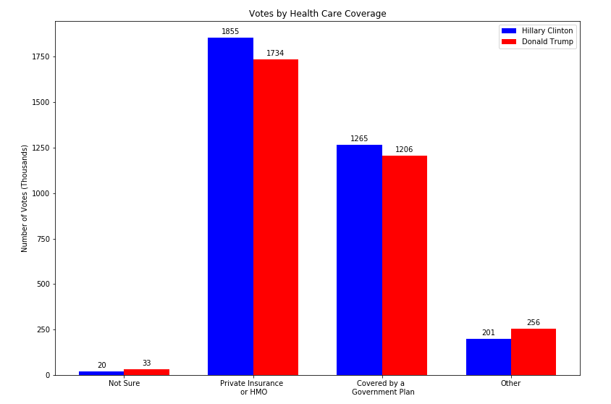
Is HEALTH CARE COVERAGE correlated with VOTER PATTERNS?
Notes:
What did we notice? Not much difference between the two candidates, but the majority of participants were either covered by an HMO (Health Maintenance Organization) or private insurance (3589 total) or covered by a government plan (2471 total). There was a difference of 37% between these two categories. 8% of respondents voted for other candidates.

Slide 11
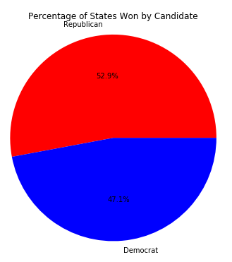
HOW DOES THIS RELATE TO ACTUAL ELECTION RESULTS?
INSERT CHART HERE
47.1%
Notes:
How does the survey data compare to actual election results. In the survey data, Democrats won 47.1% of states versus 39% in the actual election. Republicans won 52.9% of states in the survey data versus 61% in the actual election. In both sets, DC counted as a “state” since they also have electoral votes.

Slide 12
SUMMARY
Martial status did not have a significant correlation on voter trends as both breakdowns looked very similar. However, Trump did have 14.2% more married voters and Clinton had 10.2% single voters. Married voters made up majority of both parties.
For educational attainment, the largest difference was between HS graduate (Trump) and post-grads (Clinton).
In terms of household income, Clinton had more votes on opposite ends of the spectrum (less than $10,000 - $29,999 AND $100,000 - $150,000+). Trump had more votes in the mid-range for household income ($50,000 - $99,999). At $40,000 - $49,999 there was an exact tie.
For health care coverage, there were no major differences between the two candidates. The majority of voters were covered by private insurance or HMO.
Finally, we compared our survey data to actual election results. In the actual election 8% more states went Republican than in our survey data.
Notes:
What did we notice?

Slide 13
WHAT DOES THIS MEAN?
Differences were not as significant as we were expecting them to be.
Our sample size may be skewed due to the sampling method. We did not compare the demographics of our participants to that of the general public. So, it is difficult to know if our sample was representative of 2016 voters. If given more time, we would do more comparative analysis on this.
Additionally, we were curious how voter registration demographics compared to the actual voting behavior.
Notes:
What did we notice?

